Slide 1
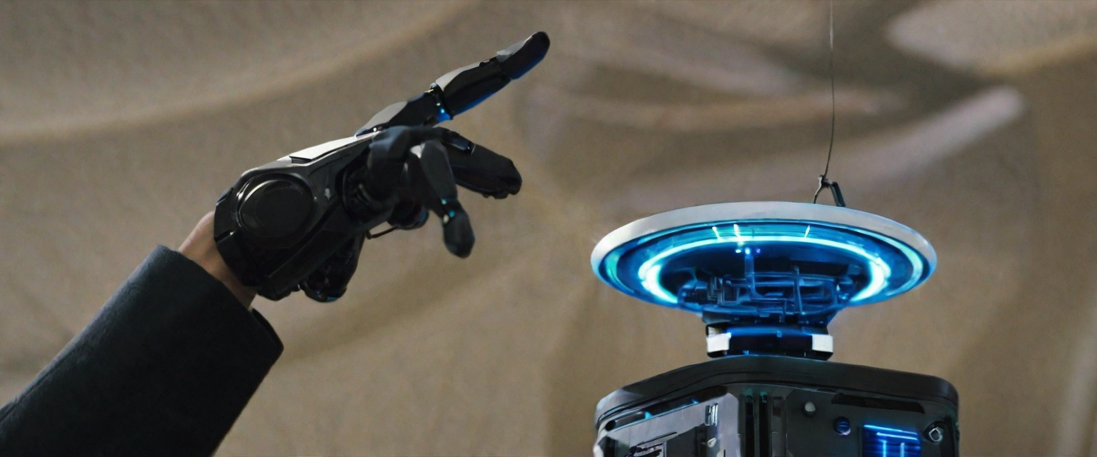
Omnidirectional Robot with Gesture Control

Slide 2
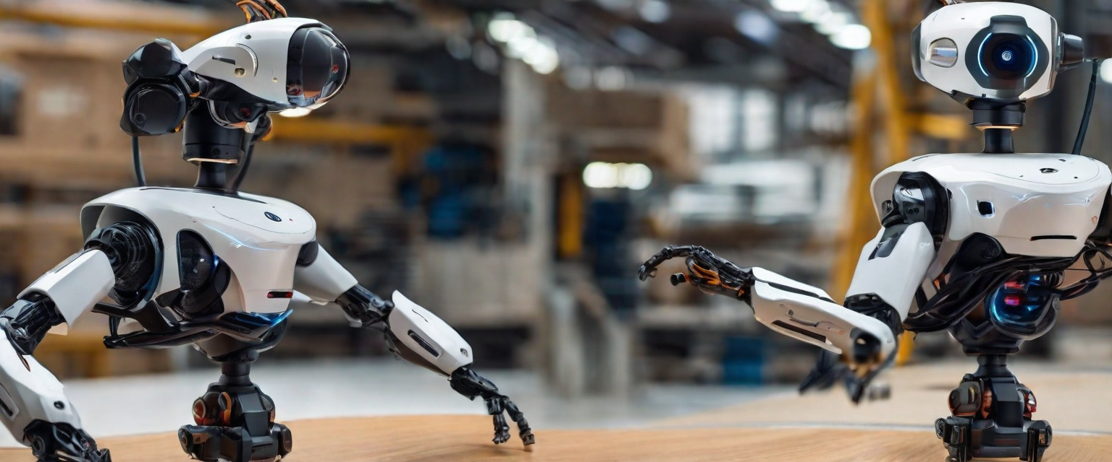
Introduction to Omnidirectional Robot with Gesture Control
The omnidirectional robot with gesture control is an innovative technology that allows users to interact with the robot using simple hand movements and gestures. This cutting-edge robot is designed to move in any direction with ease and precision, making it highly versatile and adaptable for various applications.

Slide 3
Omnidirectional Robot Components
ATMEGA 128 Microcontroller development board
DC Motor
Omni Wheels
DTMF decoder
Integration
The DC Motor, Omni Wheels, and DTMF Decoder will be integrated into the Omnidirectional Robot with Gesture Control. The microcontroller will control the movement of the robot using the DC Motor and Omni Wheels. The DTMF decoder will be used to detect and respond to user gestures, allowing for intuitive control of the robot.

Slide 4
Gesture Control System
Introduction
The omnidirectional robot is equipped with a gesture control system that allows users to control its movements using hand gestures.
How it Works
The gesture control system uses a combination of sensors and machine learning algorithms to interpret hand movements and translate them into specific commands for the robot.

Slide 5
Recognizing Gestures
The system is trained to recognize a set of predefined gestures, such as swiping left or right, pointing, and making a first.
Controlling Movements
Each recognized gesture corresponds to a specific movement or action for the robot. For example, swiping left or right can make the robot turn in that direction, while pointing can make the robot move towards the pointed direction.

Slide 6
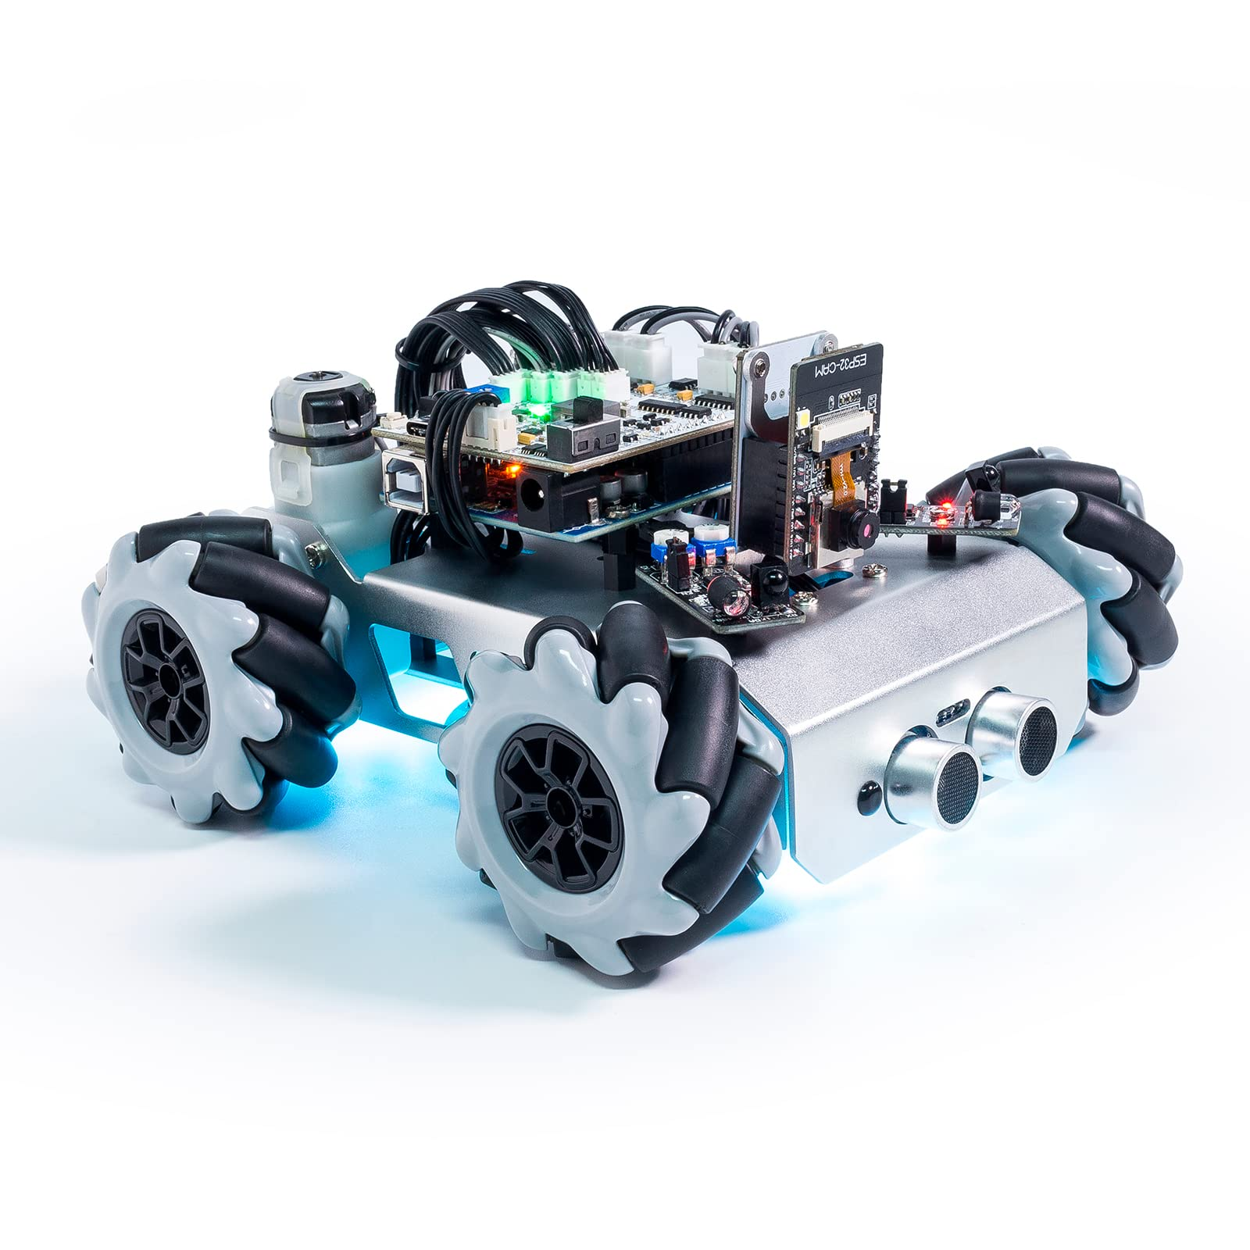
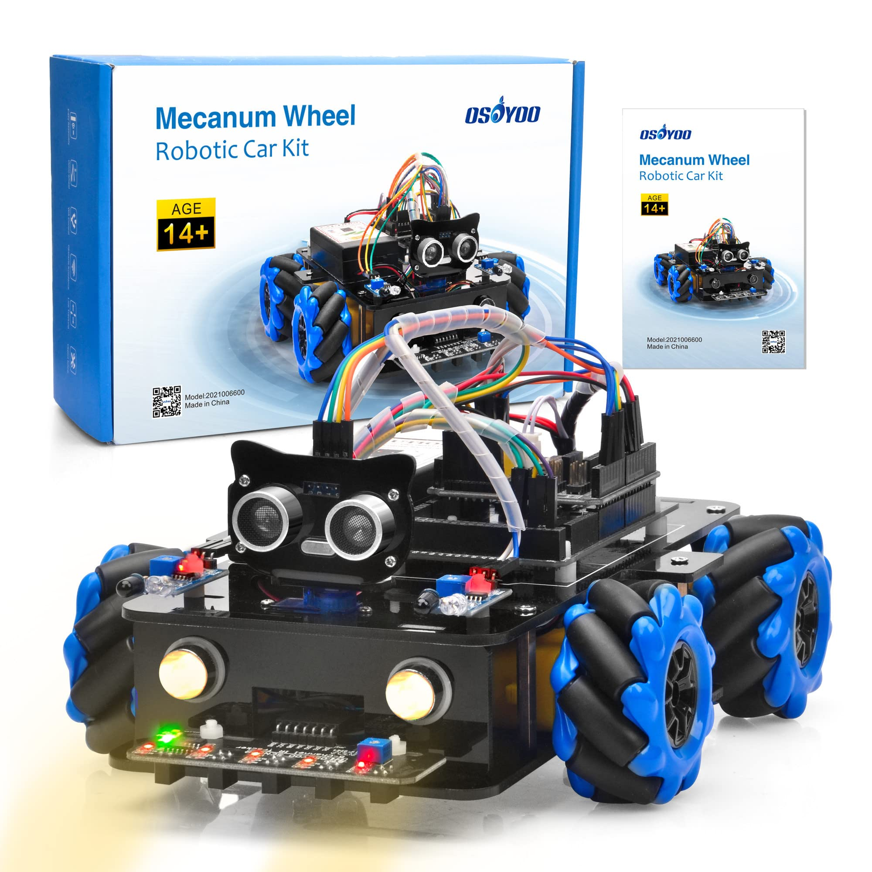
Omnidirectional Robot with Gesture Control Algorithm
Motion Planning Algorithm
The Omnidirectional Robot with Gesture Control uses a motion planning algorithm to navigate its environment. This algorithm takes into account the robot's current position, the desired destination, and any obstacles in the way to plan the most efficient path to reach the destination.

Slide 7
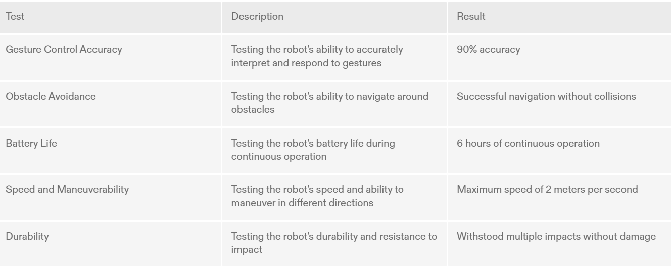
Testing and Results

Slide 8
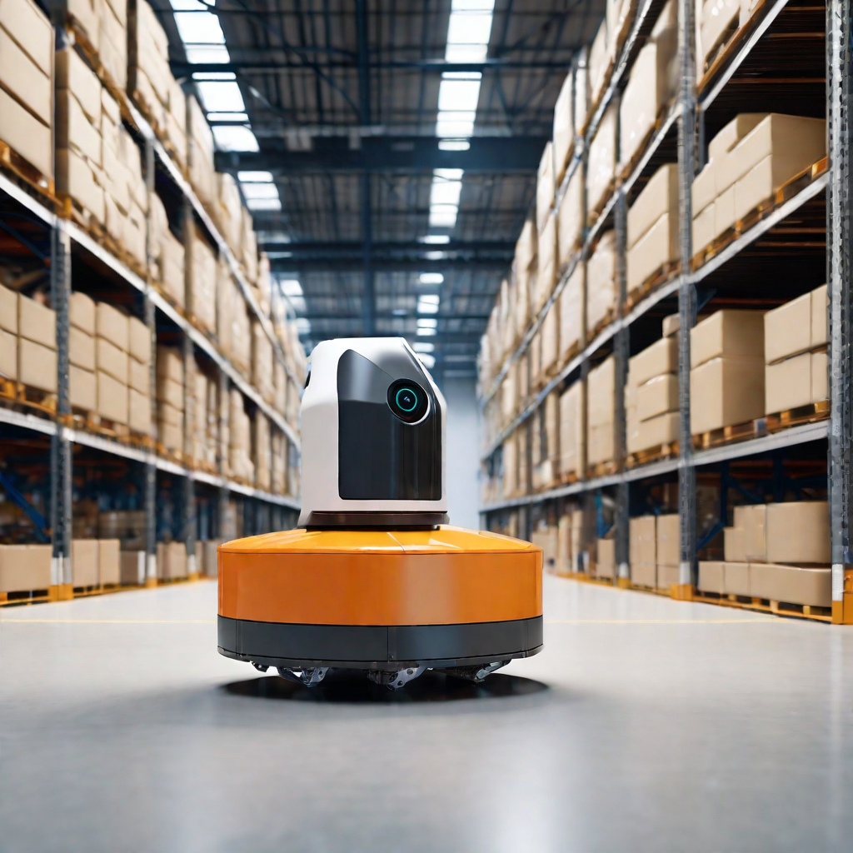
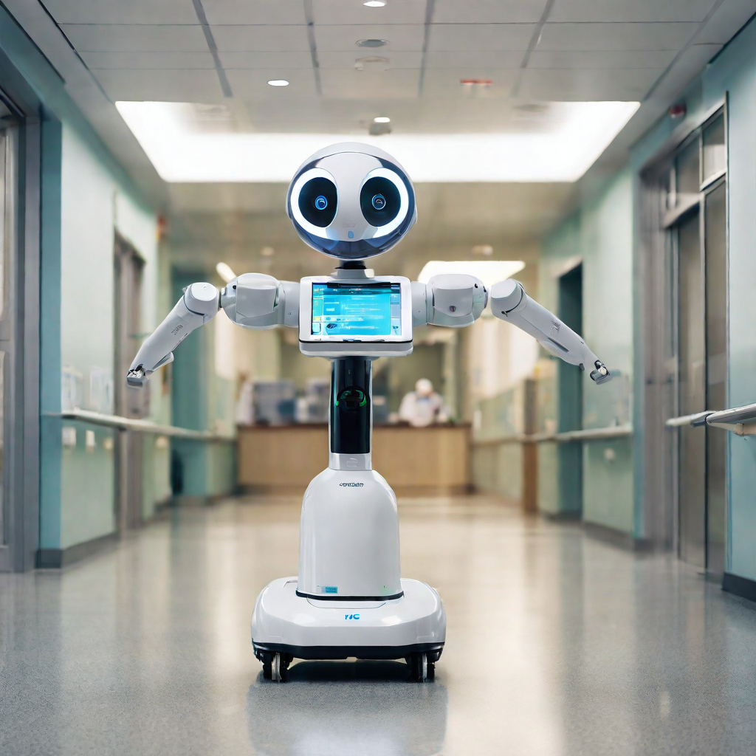
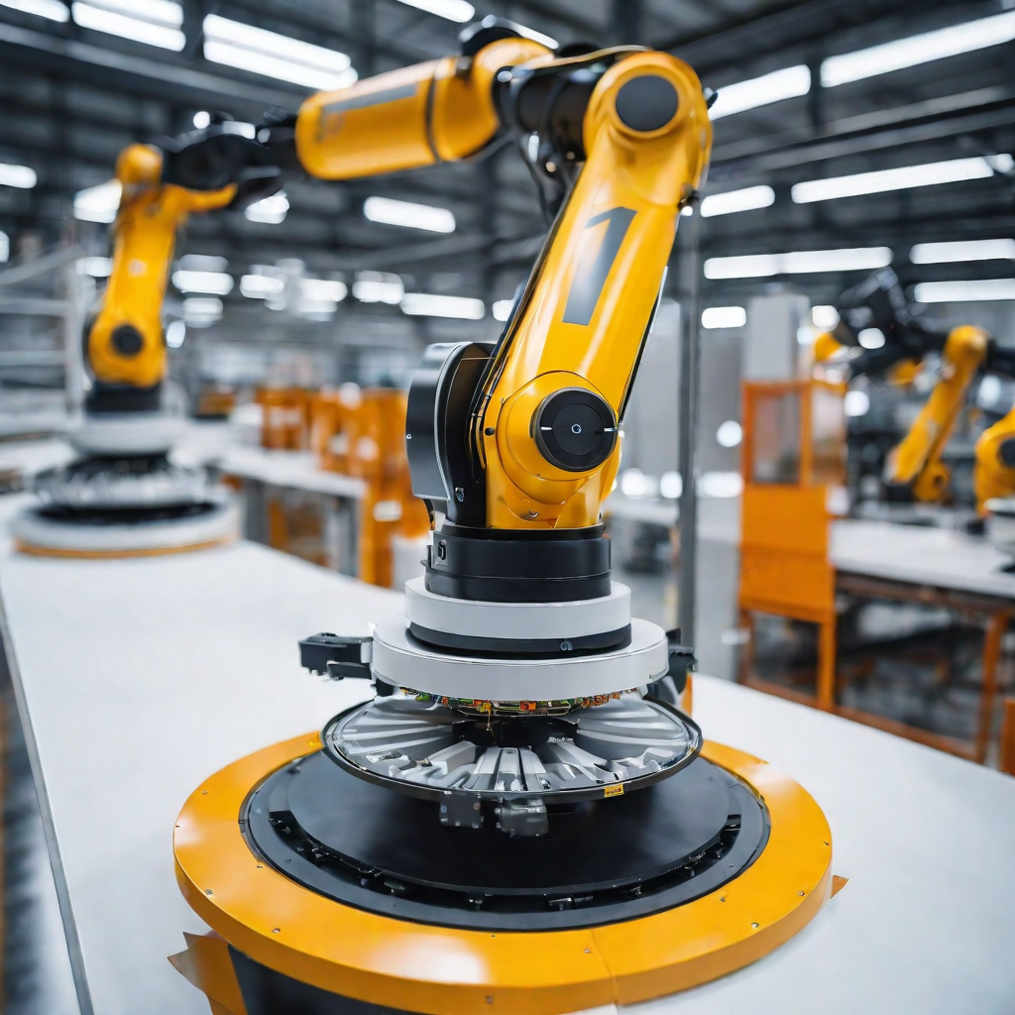
Applications
Warehousing
Healthcare
Manufacturing

